Slide 1

WEB-420
RESTfuls APIS
Douglas Jenkins

Slide 2
What Are RESTful APIs?
RESTful API is is a program that uses HTTP requests to access data.
APU is an application programming interface. It is a set of rules that will at the programs to communicate with each other.
Developers make the API on the server so that the clients will be able to talk to it.
The part where REST comes in is it determines what the API will look like.
A rule that comes with making the API for REST is that you should be able to get a resource when you link to a specific URL
Each URL is known as a request while the data that is sent back to you is called a response.

Slide 3
How Are RESTFUL APIS used?
RESTful API web services are a big part of it and below is some information that I found that helps this statement.
RESTful API contains an endpoint URL that will define one or more URL endpoints with a domain and other ports.
HTTP methods which to you using CRUD (create, read, update and delete).
HTTP headers using cookies that will be contained in the header.
Body data is transmitted in the HTTP body un a way similar to the <form>.
Response is a return format that will display the data.

Slide 4
Advantages of restful apis
It is simple and to build and adapts very well.
Low use of resources.
The initial URI helps so it does not require the client to use routing information.
Clients can use a generic interface that will listen for notifications.
Since there is separation between the client and server the protocol makes it easy to be developed on various areas of a project.
REST API adapts at all times to the working syntax and platforms.

Slide 5
Advantages of restful apis
It has great scalability
RESTful APIs stand out due to scalability and this is because of the separation between the client and the server.
The product may be scaled by a development so it will not have as much difficulty when doing it.
Flexibility and portability
It is possible to perform a migration from one server to the another or even carry out changes on the database at any time.
With the flexibility it can be hosted on different servers which would help with the management part of this.

Slide 6
DISadvantages OF RESTFUL APIS
There are a few constraints that you should think about when you decide if you are going to use RESTful APIs.
The use of use of a uniform interface
Stateless operations
The dependence on Cache
Layered system architecture
The transmission of code on demand

Slide 7
WHAT IS URL
URL stands for Uniform Resource Locator.
URL works with URI and it specifies where a resource is existing and the also retrieves it.
The purpose of it is to get the location or address of the resource.
Protocol information is given in the URL.
URL can only used to locate web pages
All URL can be URIs

Slide 8
WHAT IS URI
URI is know as User Resource Identifier.
URI is an identifier of very specific type of resource. Thinks like a book to document.
The main goal of URI is to find a resource and make it different from the resources by using a different name or location.
URI is used in HTML, XML and many other things.
There will never be protocol information in the URI.
Not all URIs are URLs since a URI can be a just a name versus it being a located.

Slide 9
WEBSITE COMMuNiCATIONS
After looking through figures 1 - 5 in the text book I was able to come up with this information.
When it comes to using Website communications I got that a website is able to communicate via URLs.
After a link is clicked you will telling the bowser to make an HTTP request that will allow the information to sent.
A GET request is made which pulls the information that you will desired to be sent over.
The server will handle this GET request by sending at as a link.
The POST request will be triggered.

Slide 10
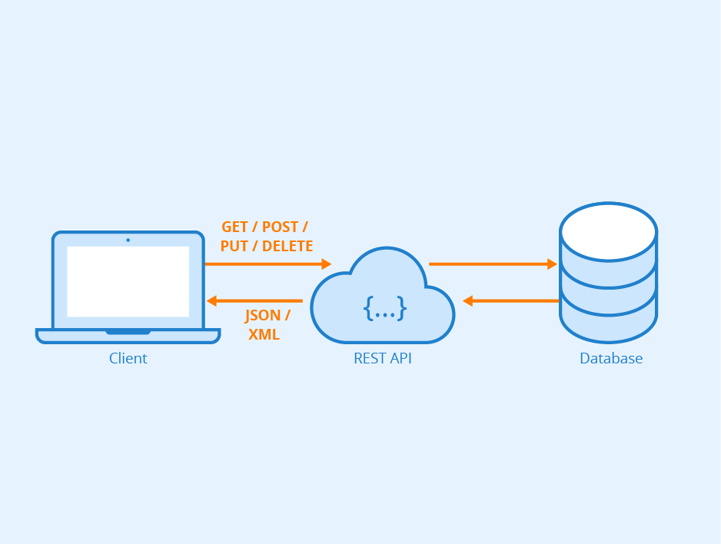
EXAMPLE OF WEBSITE communicationS

Slide 11
Sources
https://danielmiessler.com/study/difference-between-uri-url/
https://www.guru99.com/url-vs-uri-difference.html#2
https://www.smashingmagazine.com/2018/01/understanding-using-rest-api/
https://www.chakray.com/advantages-of-rest-api/
http://www.highdefgeek.com/pros-cons-using-rest-api-design/
https://www.sitepoint.com/developers-rest-api/

